Slide 1
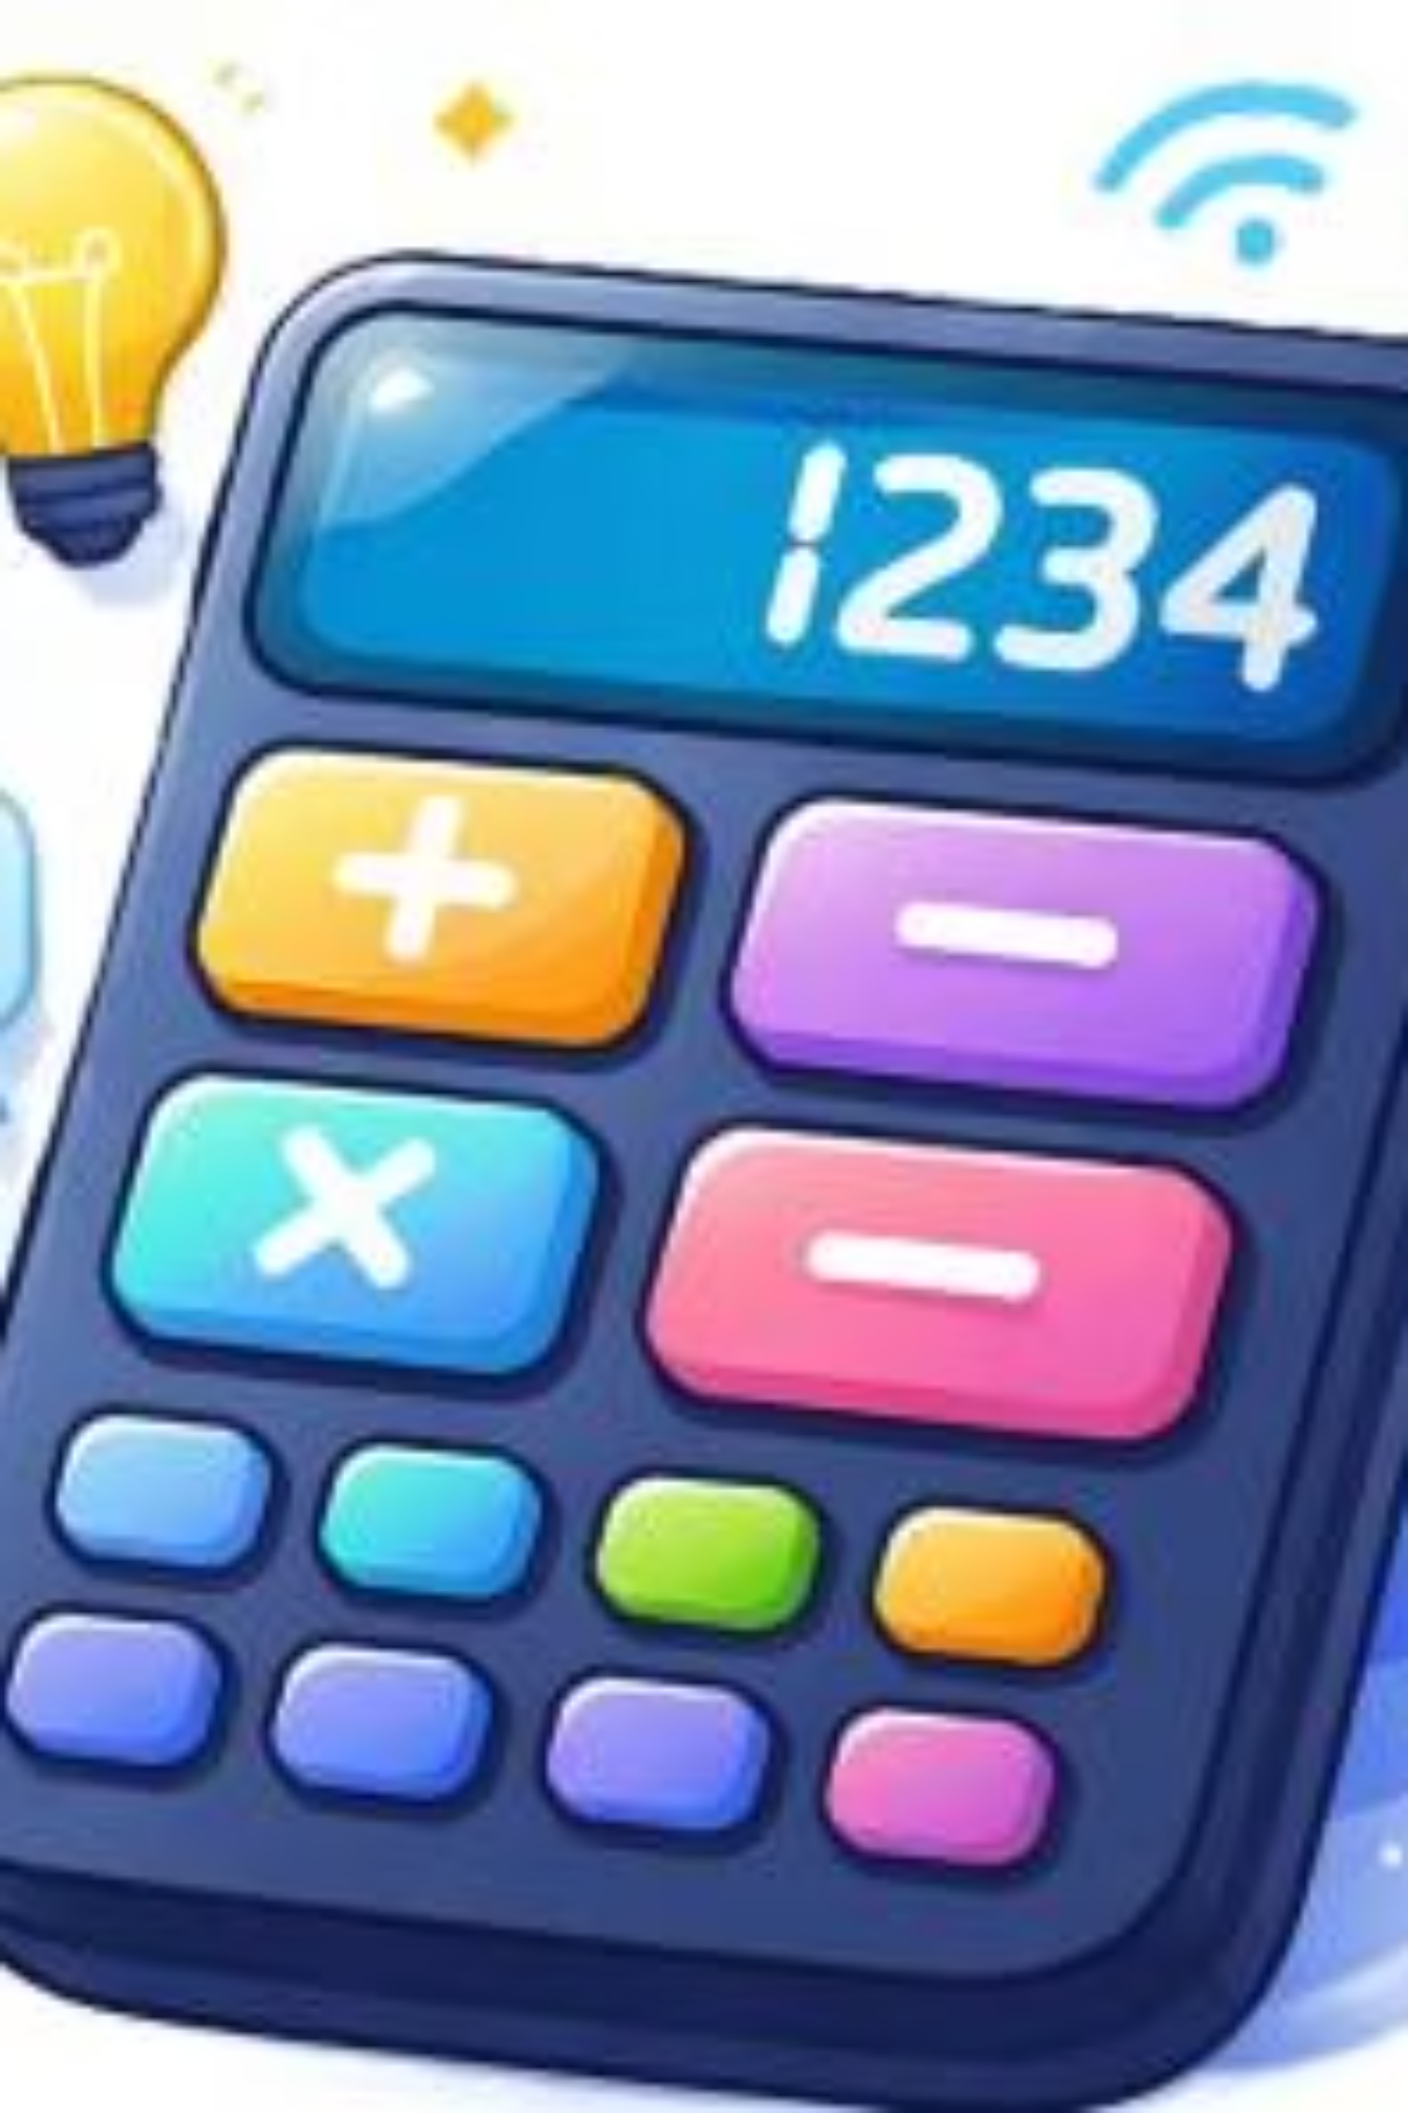
Agile Professional Final Project
Smart Context-Aware Calculator Development
Course: The Agile Professional (SE 3122)
Instructor: Dr. KEYAMPI WATIO Martial
Date: 26/11/2024 | Duration: 4 Weeks | Team Size: 9 Members

Slide 2

CHAPTER 1
Agile Framework Selection & Justification
Scrum
Kanban
Hybrid (Scrumban)
Time-boxed sprints, defined roles & ceremonies.
Visual workflow, continuous delivery.
Combines the best of both methodologies for optimal flexibility.
The team selected a hybrid Agile framework, combining Scrum and Kanban, based on their complementary strengths and suitability for the project's scope and team dynamics.

Slide 3
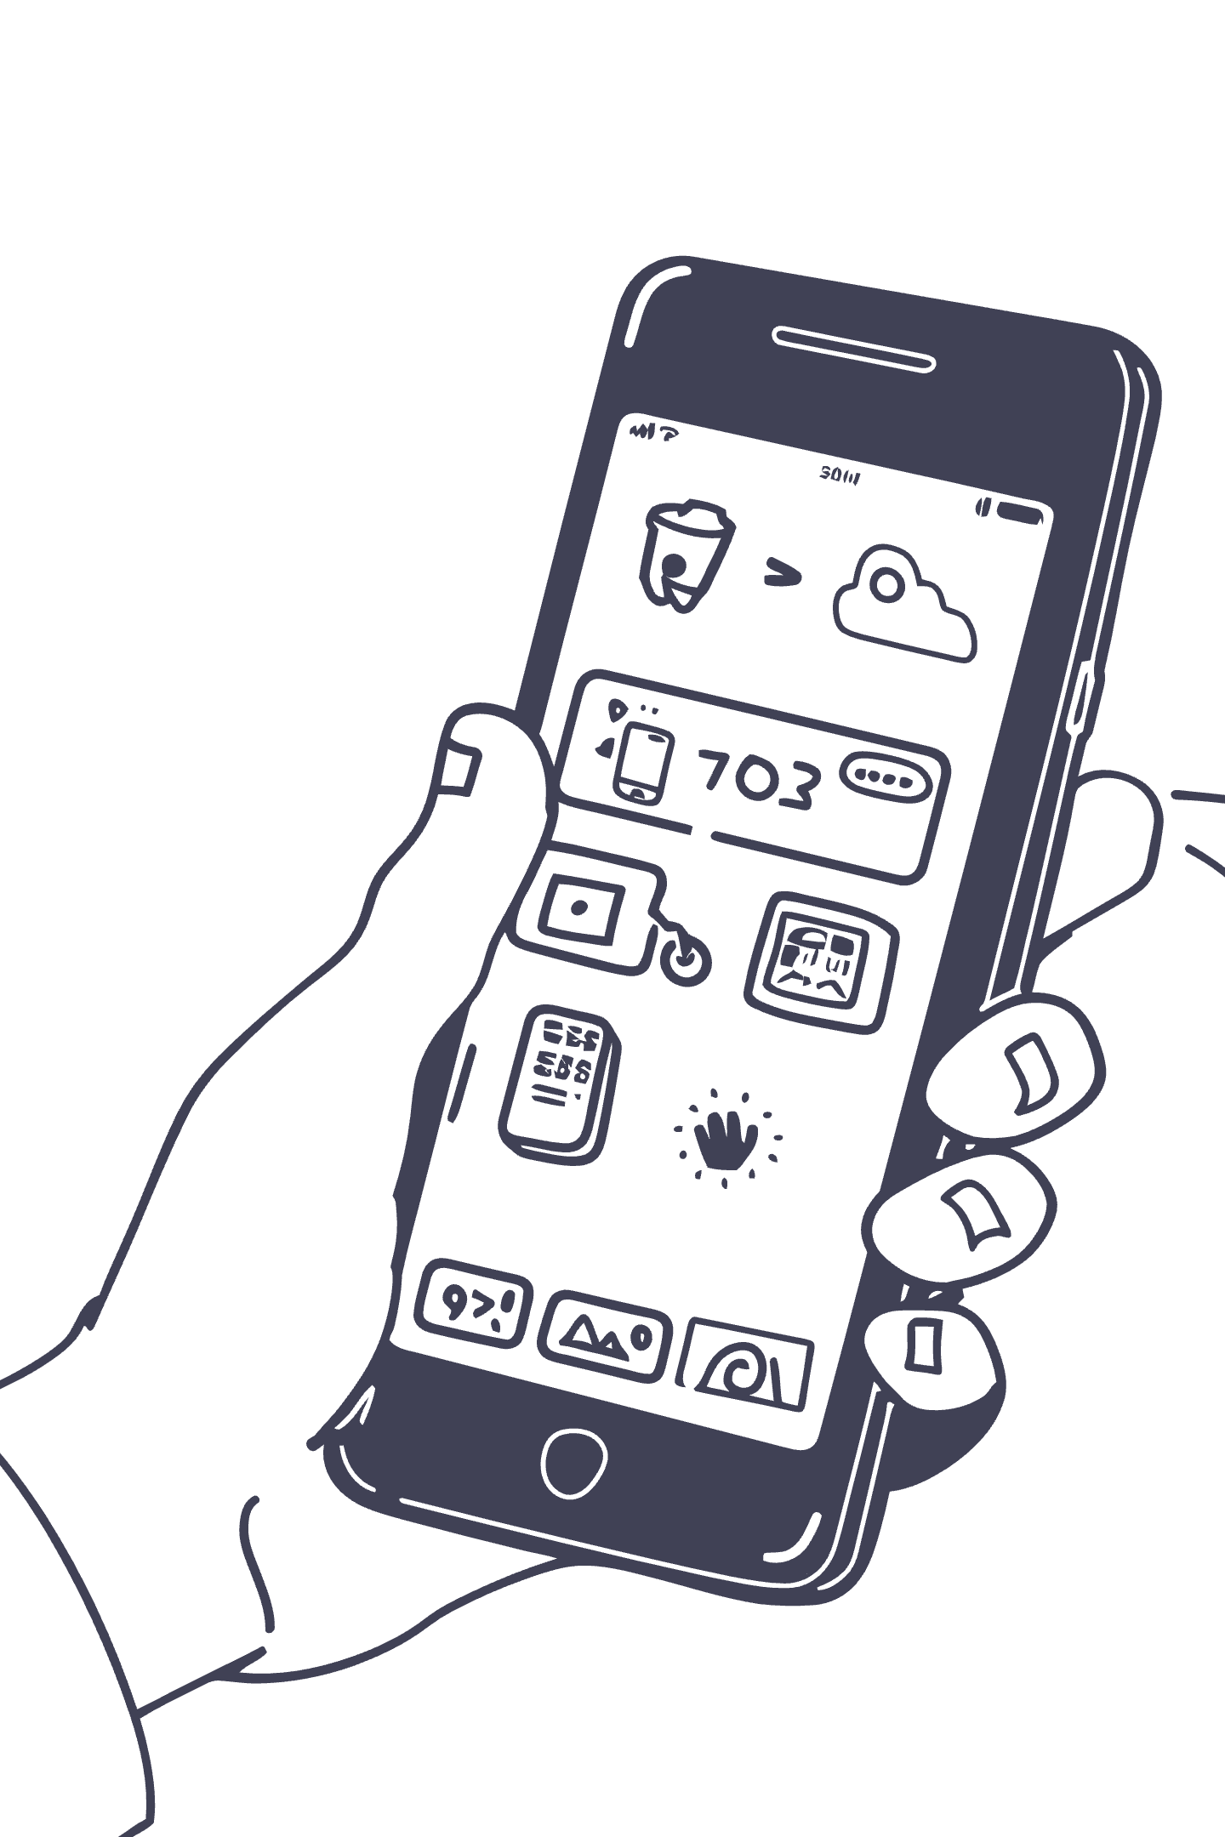
CHAPTER 1
Why a Smart Calculator for Agile Learning?
1
Technical Complexity
Perfect balance of challenge and achievability for a learning project.
2
Clear Requirements
Well-defined scope with measurable outcomes for effective tracking.
3
Incremental Development
Natural progression from simple to advanced features, ideal for iterative sprints.
4
Team Collaboration
Required diverse skills (UI, logic, testing, integration) fostering teamwork.

Slide 4
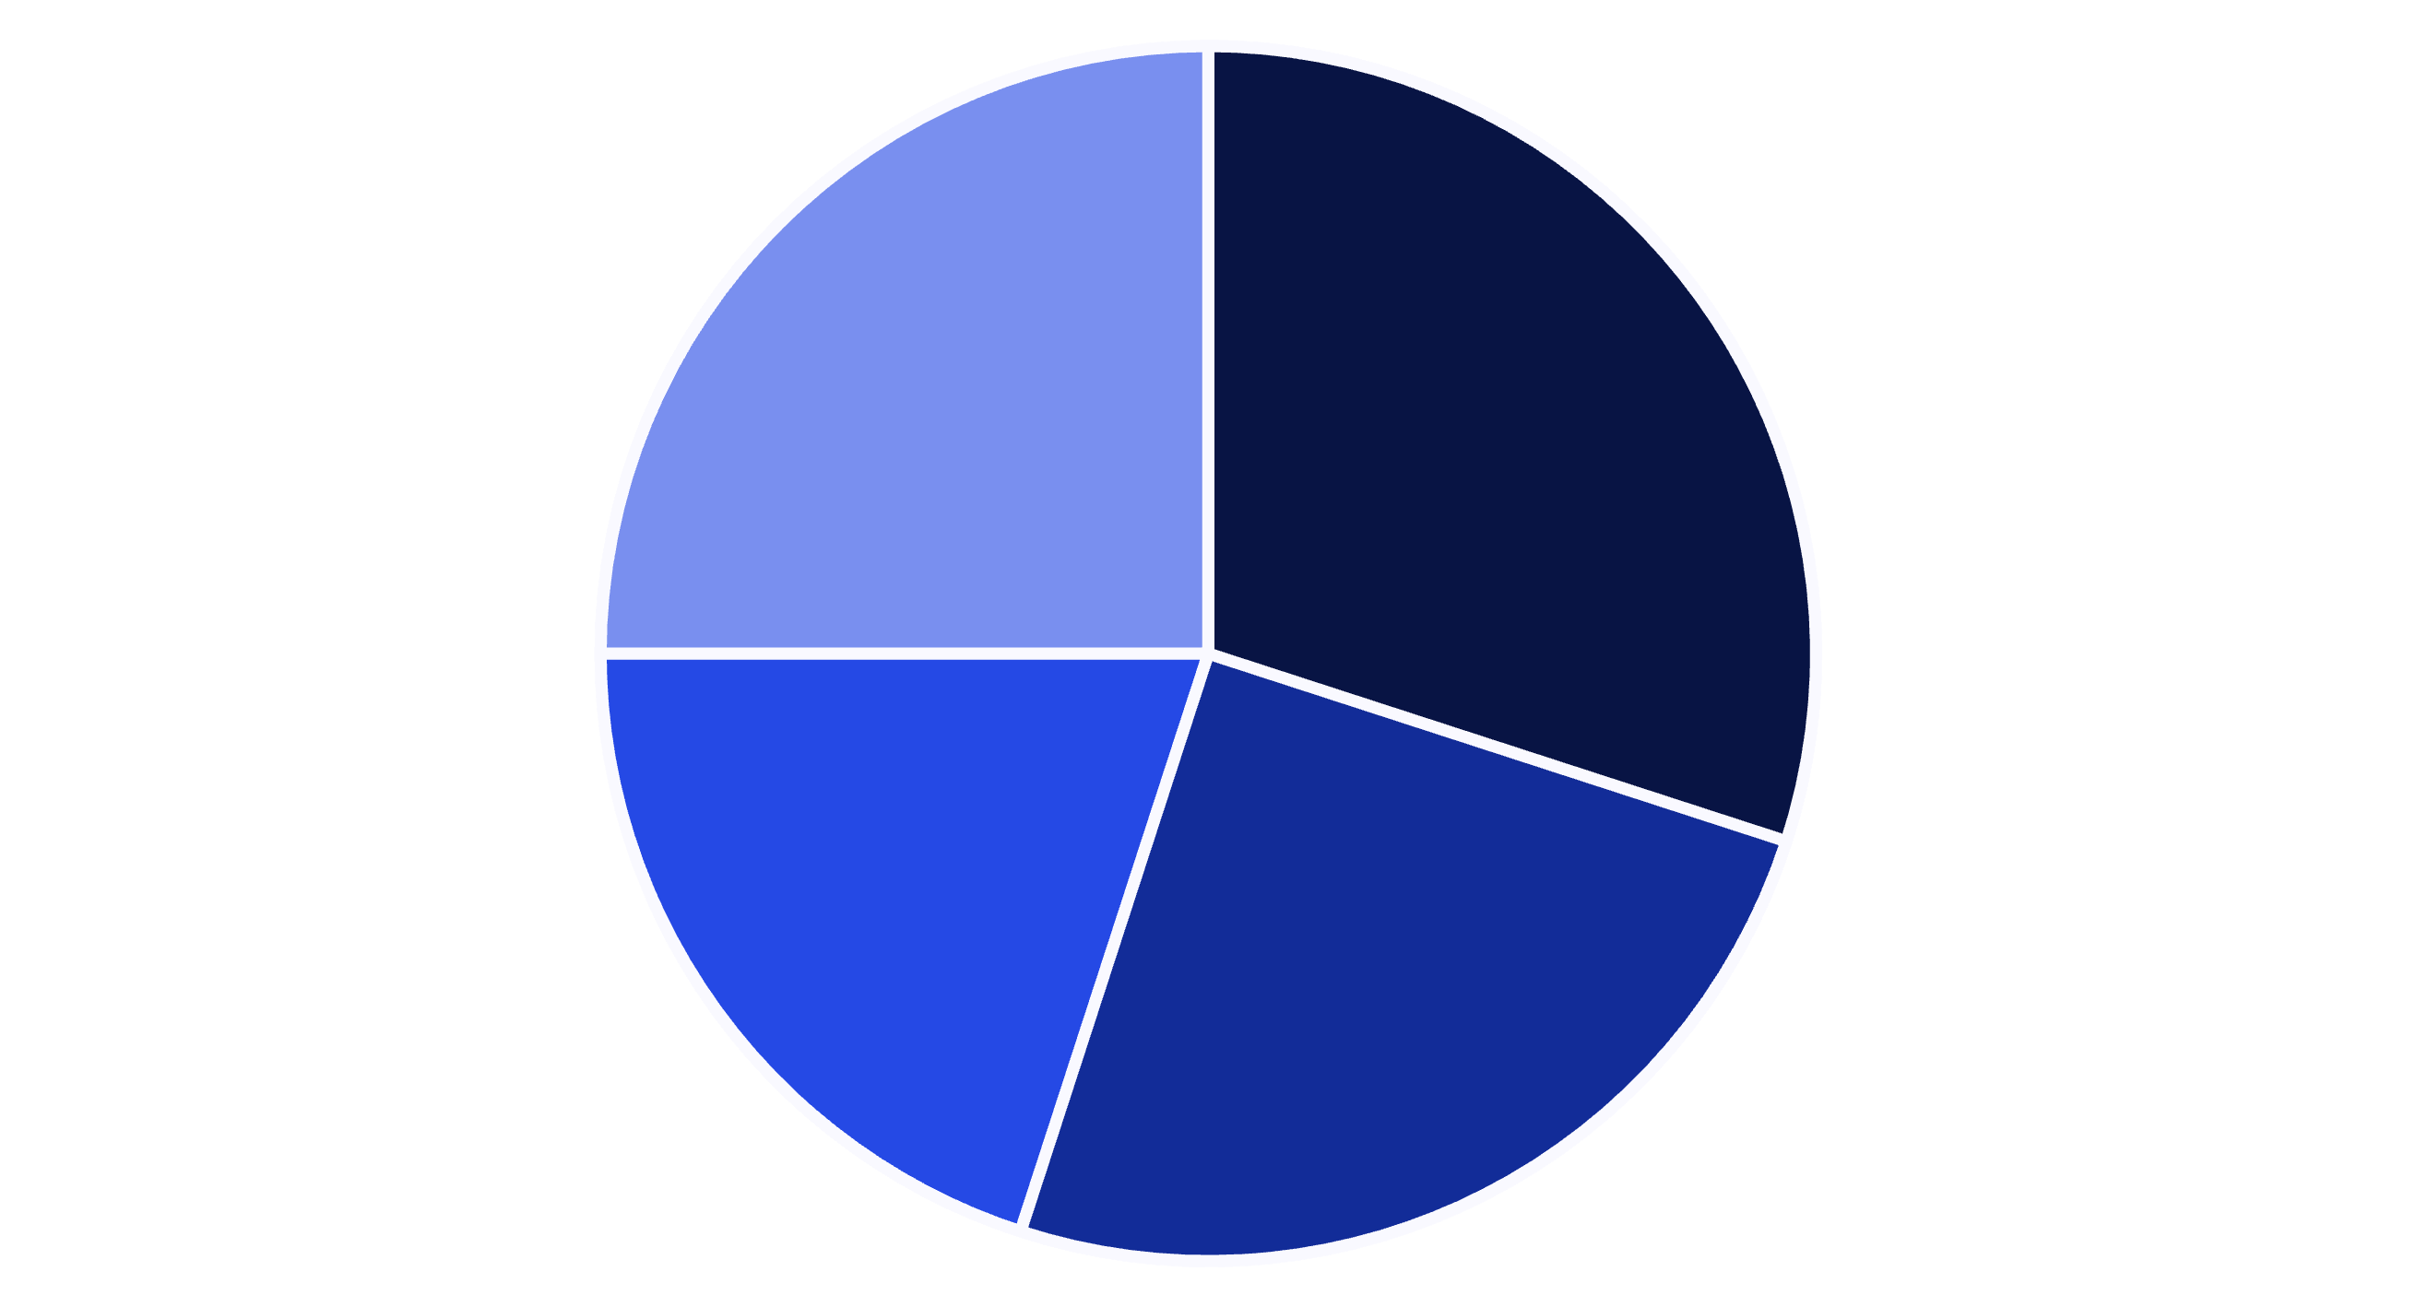
CHAPTER 1
Technical Suitability for Agile Practices
Incremental Features
Clear User Stories
Technical Diversity
Measurable Progress
The project's technical characteristics, such as its modular nature and clear user stories, made it highly suitable for demonstrating core Agile practices and ensuring measurable progress.

Slide 5
CHAPTER 2
Simulated Agile Project: Sprint Planning
1
2
Sprint 1: Standard Mode
Sprint 2: Context Modes
Deliver basic calculator with core arithmetic operations.
Implement Homework, Shopping, Budgeting, and Cooking modes.
3
4
Sprint 3: Smart Features
Sprint 4: Finalization
Integrate smart suggestions and input panels.
Focus on testing, bug fixes, and comprehensive documentation.
Each sprint had clear goals and a one-week duration, allowing for focused development and iterative delivery.

Slide 6
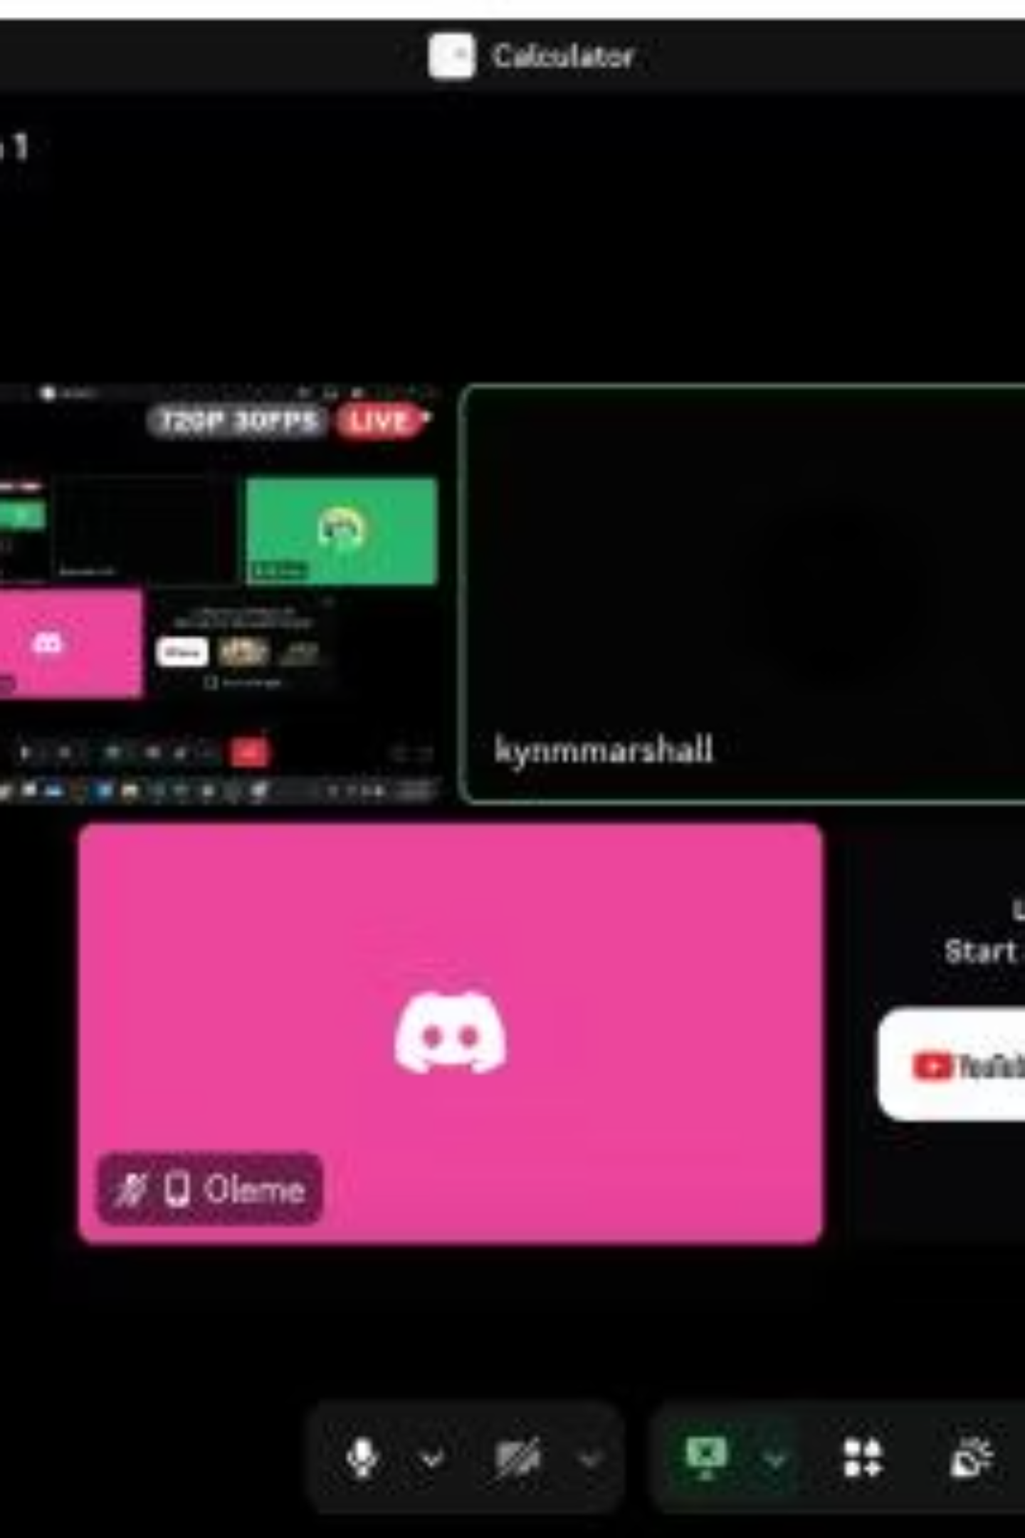
CHAPTER 2
Sprint Execution: Daily Stand-ups
Daily 15-minute stand-ups were crucial for team alignment, sharing progress, planning daily work, and identifying any blockers or dependencies.
Progress Sharing
Updates since the last meeting.
Daily Planning
Outline of current day's tasks.
Blocker Identification
Quick resolution of impediments.

Slide 7
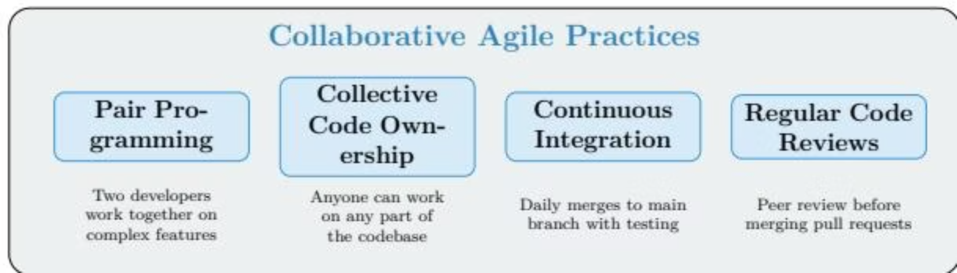
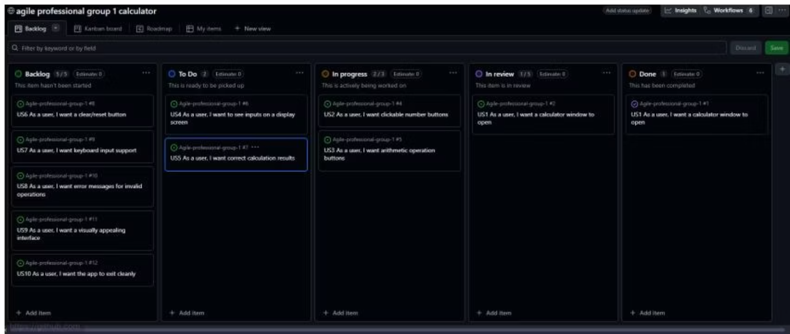
CHAPTER 2
Collaborative Work Practices & Kanban
The team leveraged practices like pair programming, collective code ownership, continuous integration, and regular code reviews to ensure high-quality collaboration.
GitHub Projects served as the Kanban board, visualizing workflow and managing tasks through stages: Backlog, To Do, In Progress, Review, and Done.

Slide 8
CHAPTER 3
Challenges & Agile Solutions
Technical Challenges
Complex Feature Integration: Incremental delivery.
Technical Debt: Regular refactoring & code reviews.
Skill Variations: Pair programming & knowledge sharing.
Process Challenges
Scope Creep: Strict backlog management.
Time Estimation: Planning poker & velocity tracking.
Communication Gaps: Daily stand-ups & visual boards.
Agile principles guided the team in overcoming both technical and process-related hurdles, emphasizing adaptability and continuous improvement.

Slide 9
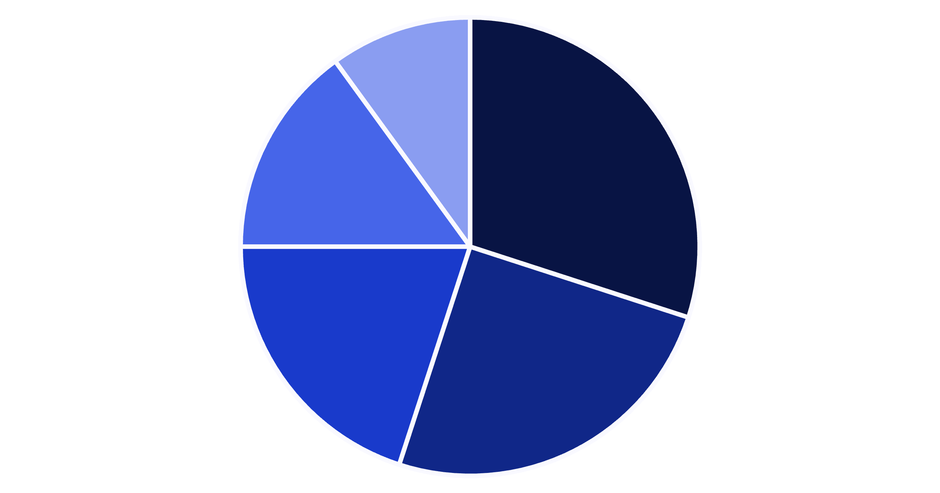
CHAPTER 4
Effectiveness of Hybrid Agile Approach
Structured Planning (Scrum)
Flexible Execution (Kanban)
Team Collaboration
Risk Mitigation
Continuous Improvement
The hybrid approach proved highly effective, balancing structured planning with flexible execution, fostering strong team collaboration, and enabling continuous improvement.

Slide 10
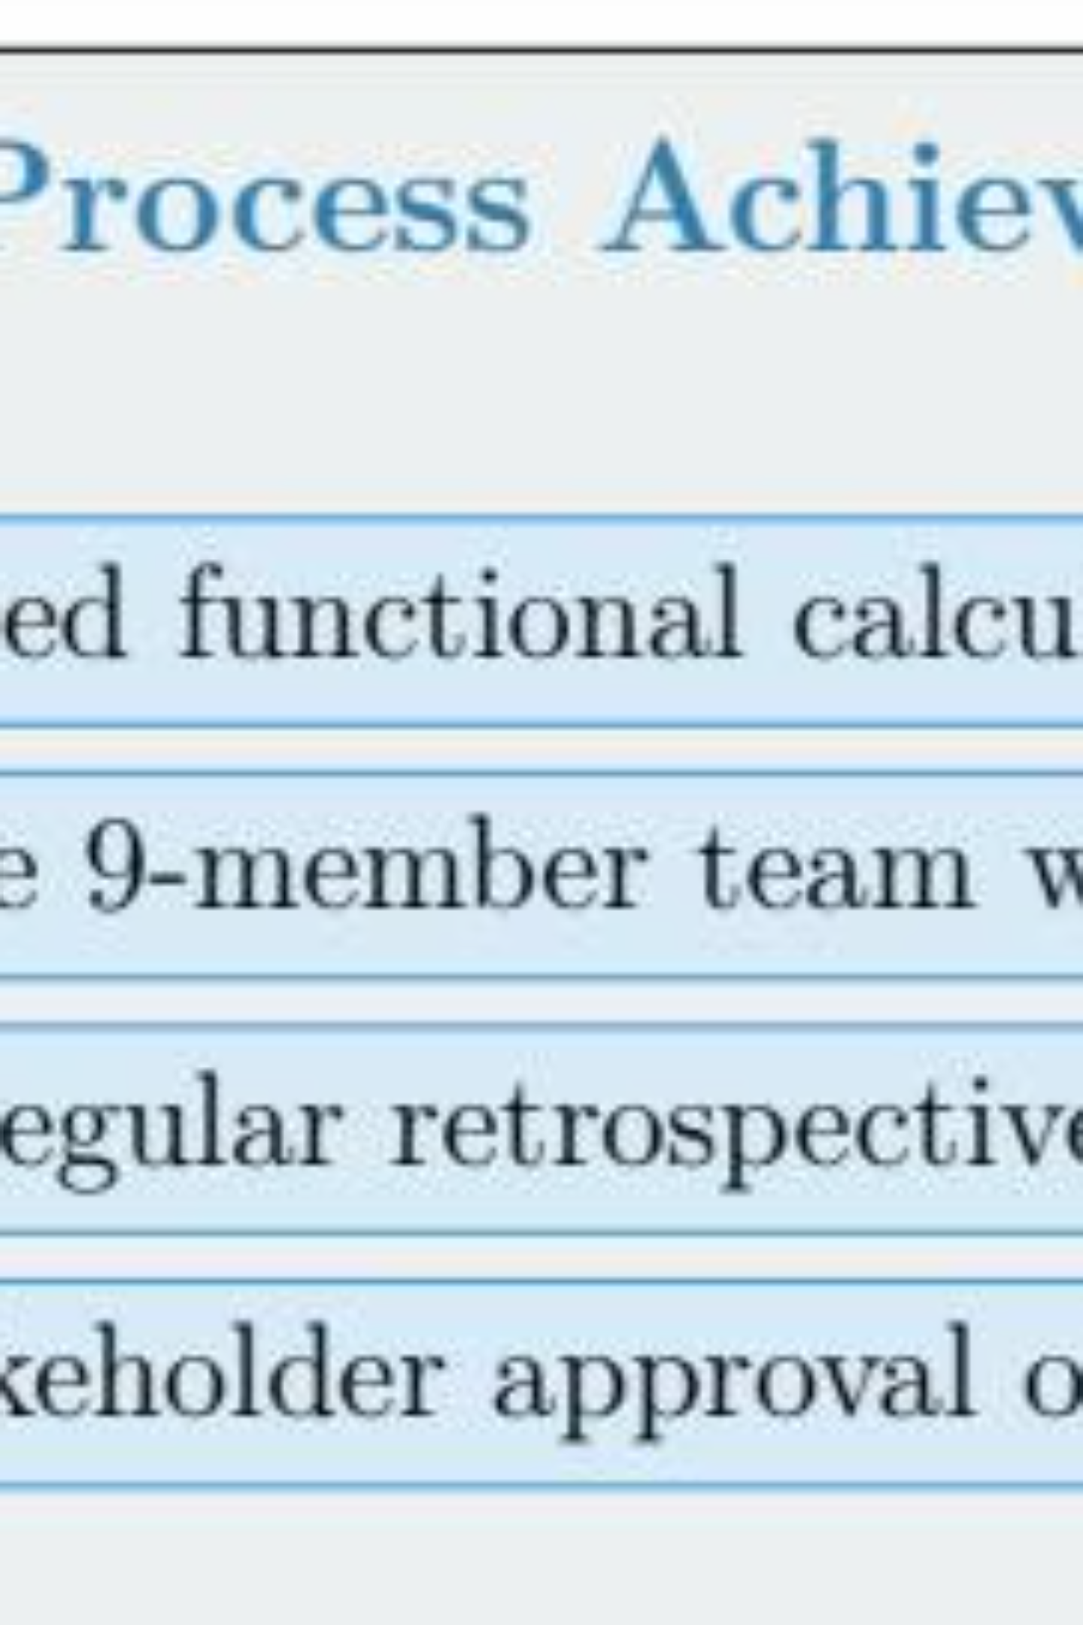
CHAPTER 4
Project Outcomes & Final Reflection
Delivered Product
1
Functional Smart Context-Aware Calculator with 5 modes, GUI, and smart suggestions.
Agile Process Outcomes
2
Effective 9-member team, continuous improvement, and stakeholder satisfaction.
Impact of Agile
3
Early delivery, adaptability, high team morale, and improved code quality.
The project successfully demonstrated Agile's value, reinforcing its role in delivering better software and fostering satisfied teams.

